Slide 1

Extension Points
WSO2 Identity Server Developer Advanced

Slide 2


Extension Points
With the WSO2 Identity Server numerous extension points, you can easily customize and enhance the authentication process to meet your specific requirements.
Java Based Extensions
Event handler (intercepts and handles events)
User store listener (intercepts and handles events in the user store)
Post authentication handler (perform custom actions after user login)
Claim handler (modify/add new claims to a user profile)
API Based Extensions
Actions: Pre Issue Access Token, Pre Issue ID Token, Pre Update Password, Pre Update Profile, Custom Authenticator
Webhooks: Login, Token, Credential, Registration, Session, User Account Management Events

Slide 3
Java Based Extension Points

Slide 4
Event Handler

Slide 5
Customized Event Processing
Based on a publish-subscribe model.
Components within the identity server can publish events and other components can subscribe to receive notifications.
Events occur for user and system operations in the Identity Server such as pre/post user addition, pre/post claim setting etc.
Supports handlers used to define actions that trigger when specific events are published.

Slide 6
Identity Server Events
An event is a specific action carried out by a user or the system.
Examples of events:
Pre add user (PRE_ADD_USER)
Post add user (POST_ADD_USER)
Authentication step success (AUTHENTICATION_STEP_SUCCESS)
Authentication step failure (AUTHENTCATION_STEP_FAILURE)
Pre authentication (PRE_AUTHENTCATION)
Post authentication (POST_AUTHENTICATION)
Find the full list of events in the documentation.

Slide 7
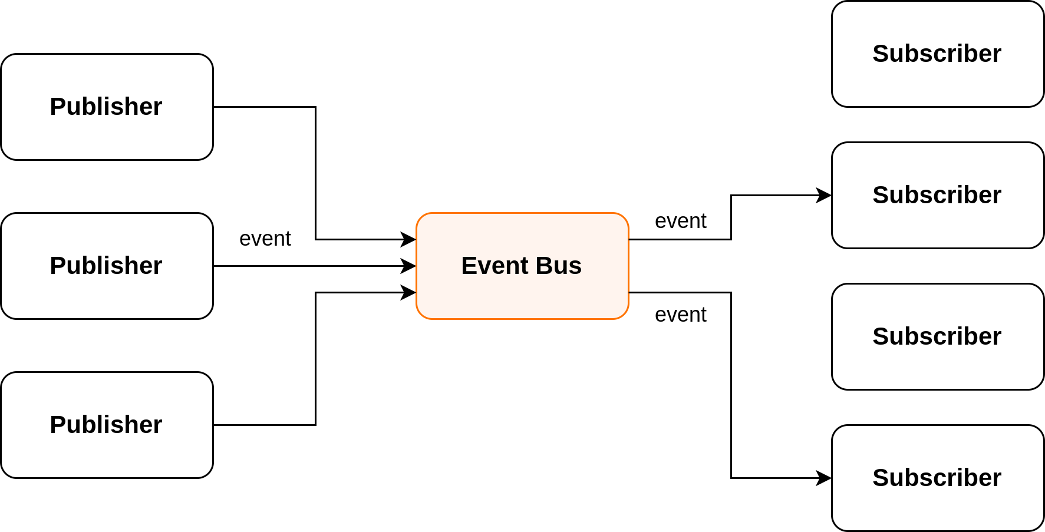
WSO2 Eventing Framework
Extensible system based on a publish-subscribe model for handling and processing events.

Slide 8
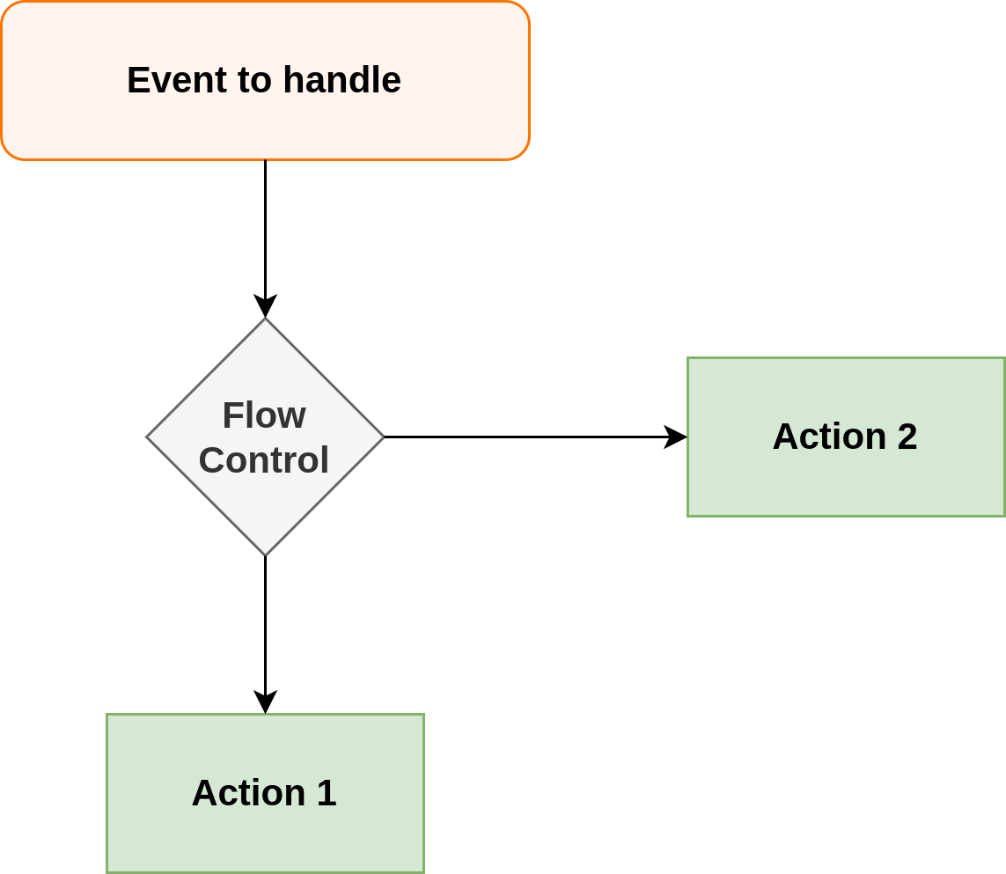
Event Handlers
Used to define custom logic to be executed when events occur.

Slide 9
User Store Event Listener

Slide 10
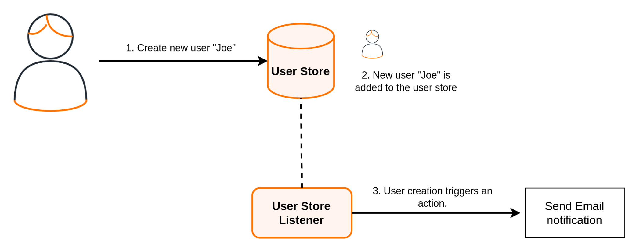
User Store Event Listener
Used to implement custom logic for user store events without overriding the core user store implementation.

Slide 11
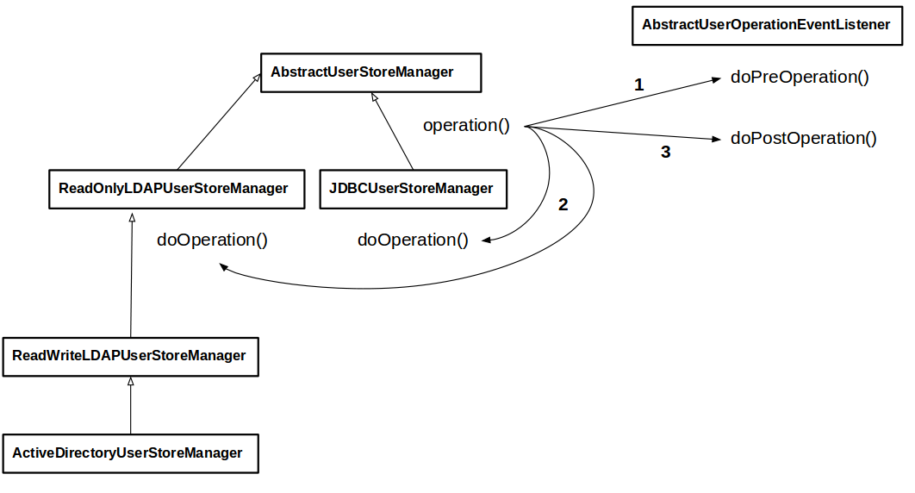
User Store Event Listener

Slide 12
Post Authentication Handler

Slide 13
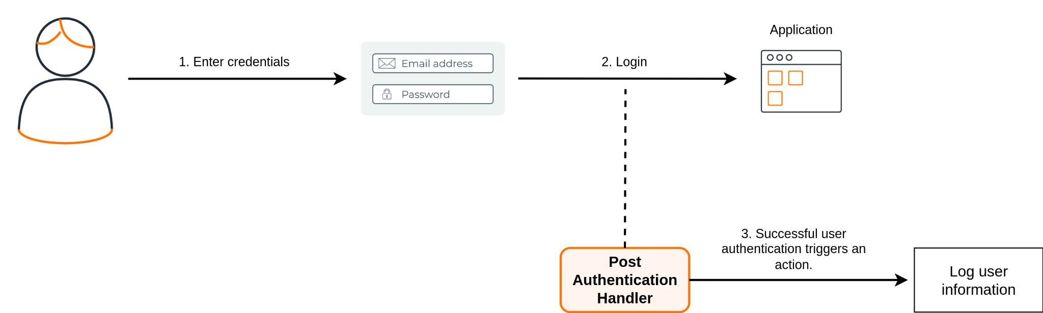
Post Authentication Handler
Used to perform custom logic upon user authentication. Authentication to the system is only successful once the execution of the post-authentication handler is completed.

Slide 14
Default post authentication handlers
ConsentMgtPostAuthnHandler
JITProvisioningPostAuthenticationHandler
PostAuthAssociationHandler
PostAuthenticatedSubjectIdentifierHandler

Slide 15
Custom Claim Handler

Slide 16
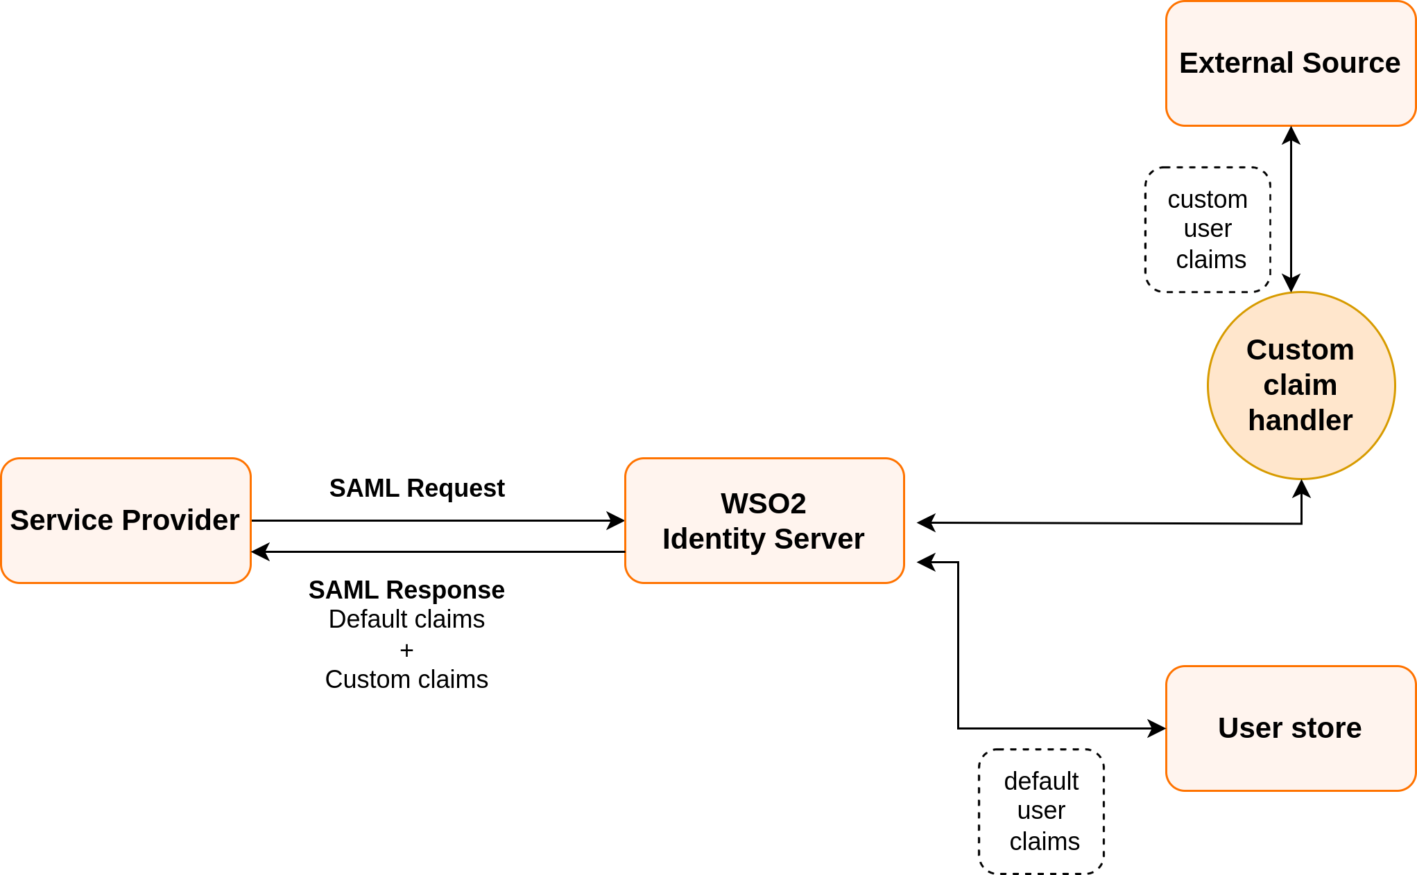
Custom Claim Handler
A custom claim handler can be used to retrieve and add external claims to SAML response.

Slide 17
API Based
Extensions

Slide 18
Actions

Slide 19
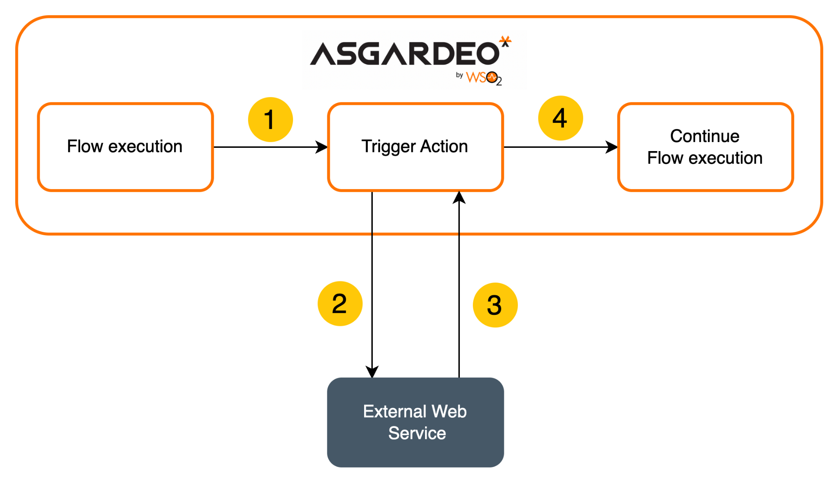
What is Action?
Actions allow you to customize specific flows by integrating custom code hosted in an external web service.
Identity Server

Slide 20
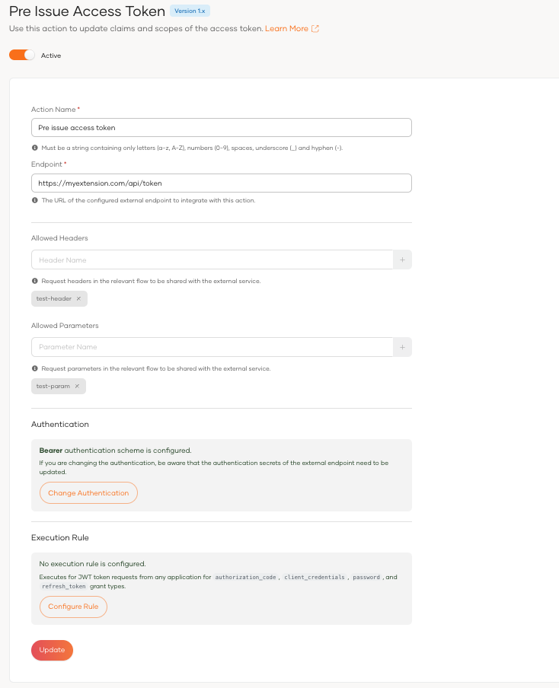
Pre Issue Access Token
Enables modification of attributes in a JWT access token
Allows:
Updating user attribute values
Adding custom claims to the JWT
Updating only following standard JWT claims
  aud (Audience)
  exp (Expiration Time)
  scope (Scopes)
Notes:
Executes in,
JWT Token flows with grant types,
Authorization code
Password
Client credentials
Refresh token

Slide 21
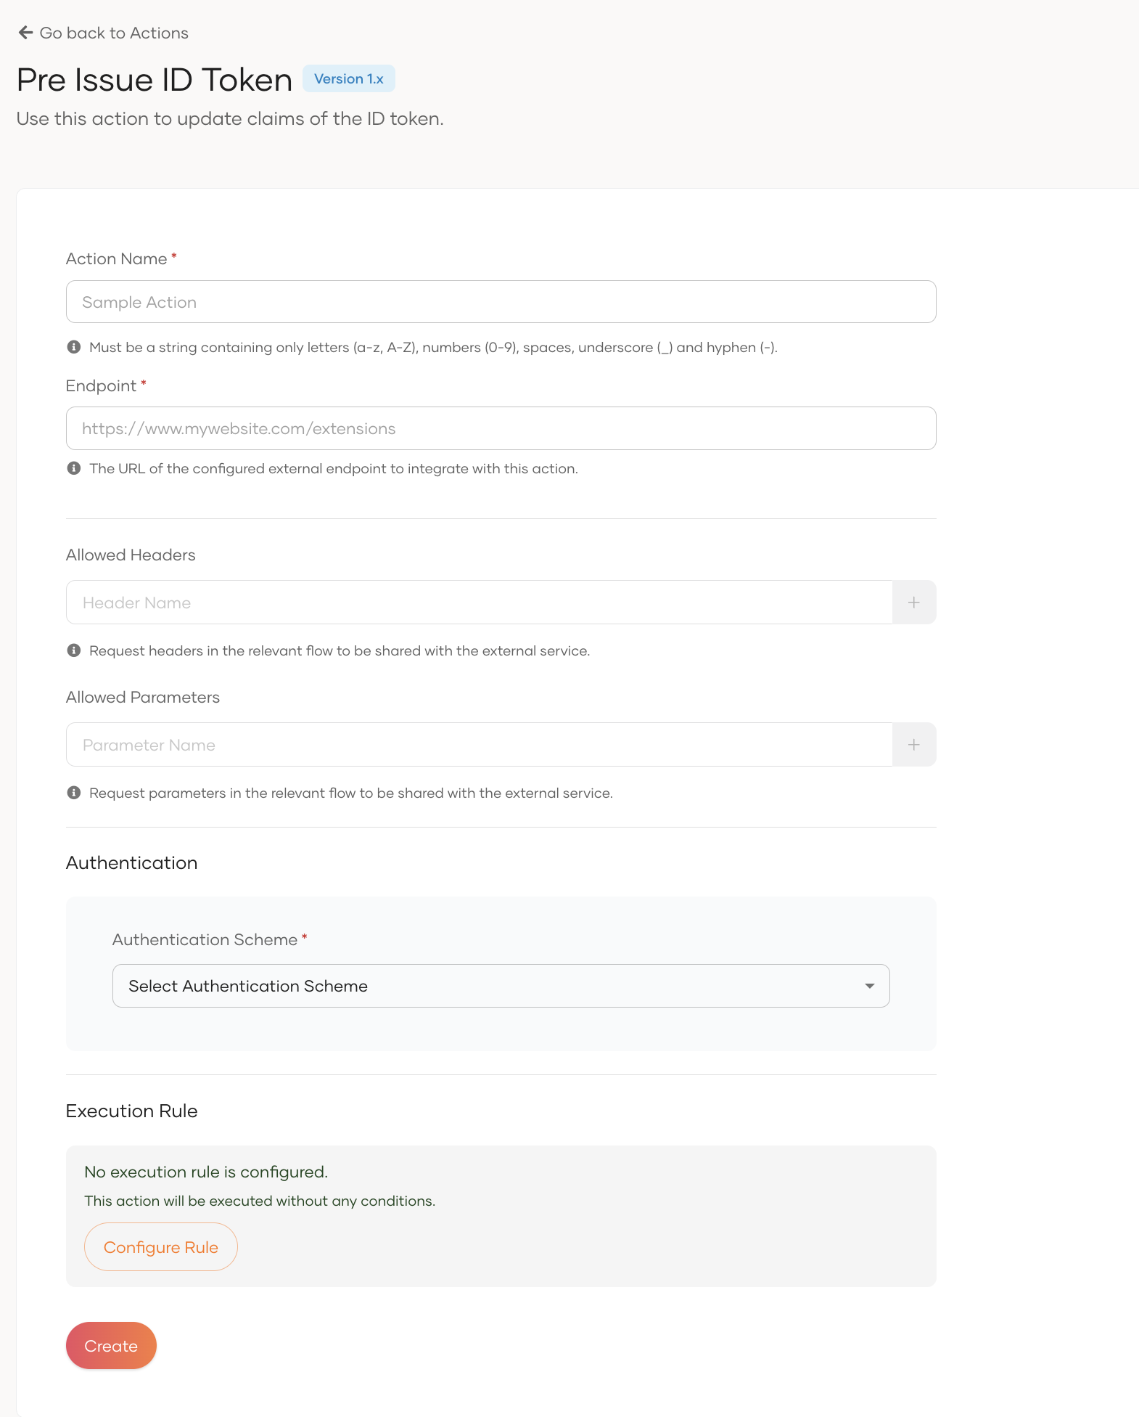
Pre Issue ID Token
Enables modification of attributes in a JWT access token
Allows:
Updating user attribute values
Adding custom claims to the ID token
Updating only following standard JWT claims
  aud (Audience)
  exp (Expiration Time)
Notes:
Executes in,
JWT Token flows with grant types,
Authorization code
Password
Client credentials
Refresh token

Slide 22
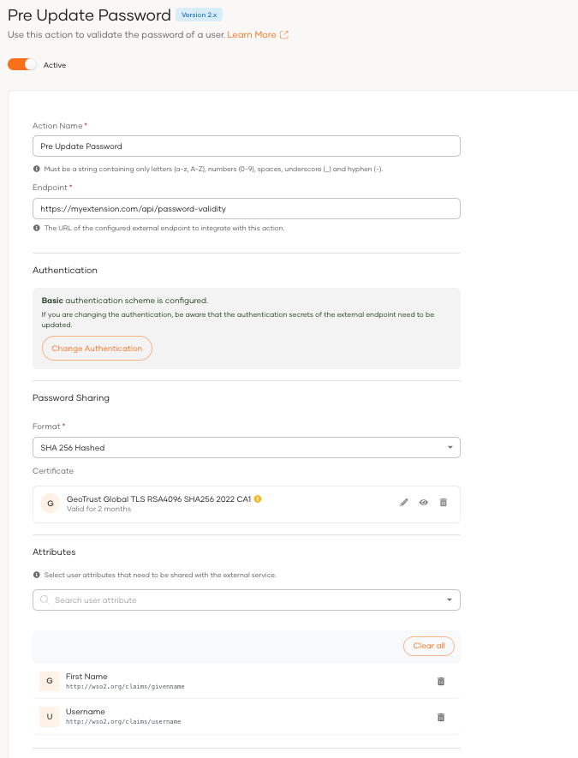
Pre Update Password
Allows you to enforce password complexity rules, notify administrators, or perform other custom logic.
Executes in,
Registration
Password update
Password reset
Notes:
In-flow extensions - Operates within a flow itself
Pre-flow extensions - Executes specific actions before a particular event or flow

Slide 23
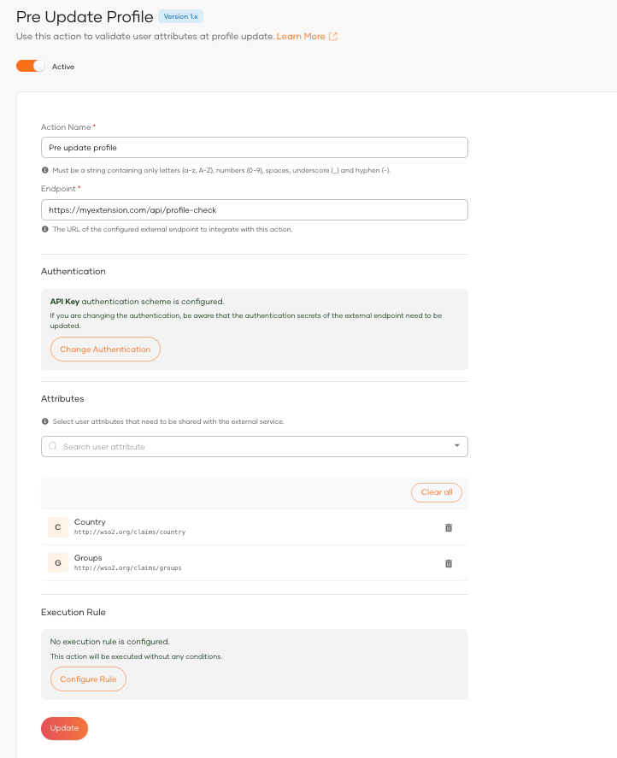
Pre Update Profile
Allows you to validate profile data, synchronize with external systems, or trigger notifications.
Executes in,
User profile update
Notes:
In-flow extensions - Operates within a flow itself
Pre-flow extensions - Executes specific actions before a particular event or flow

Slide 24
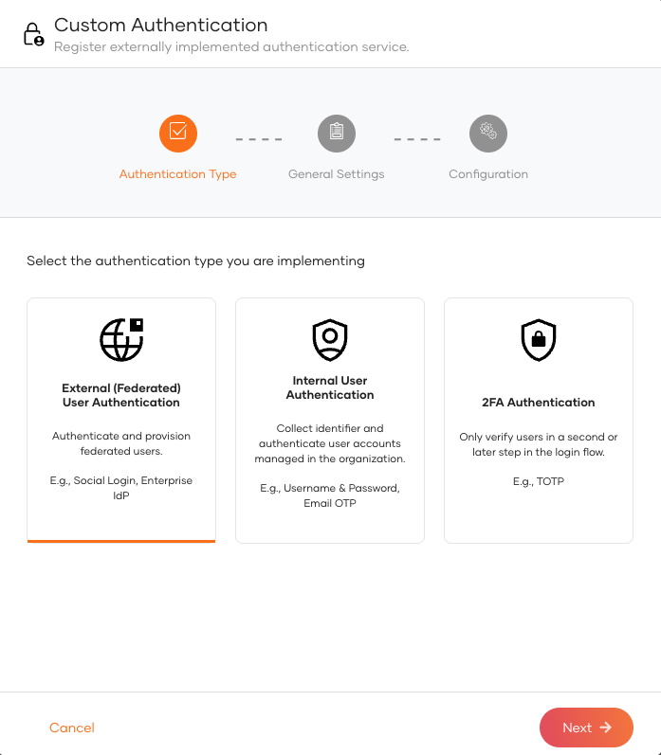
Custom Authenticator
Allows you to extend the authentication functionality.
Notes:
In-flow extensions - Operates within a flow itself
Pre-flow extensions - Executes specific actions before a particular event or flow

Slide 25
Webhooks

Slide 26
What is a Webhook?
Webhooks allow your application or service to receive real-time notifications from WSO2 Identity Server, enabling immediate responses to critical identity-related events.

Slide 27
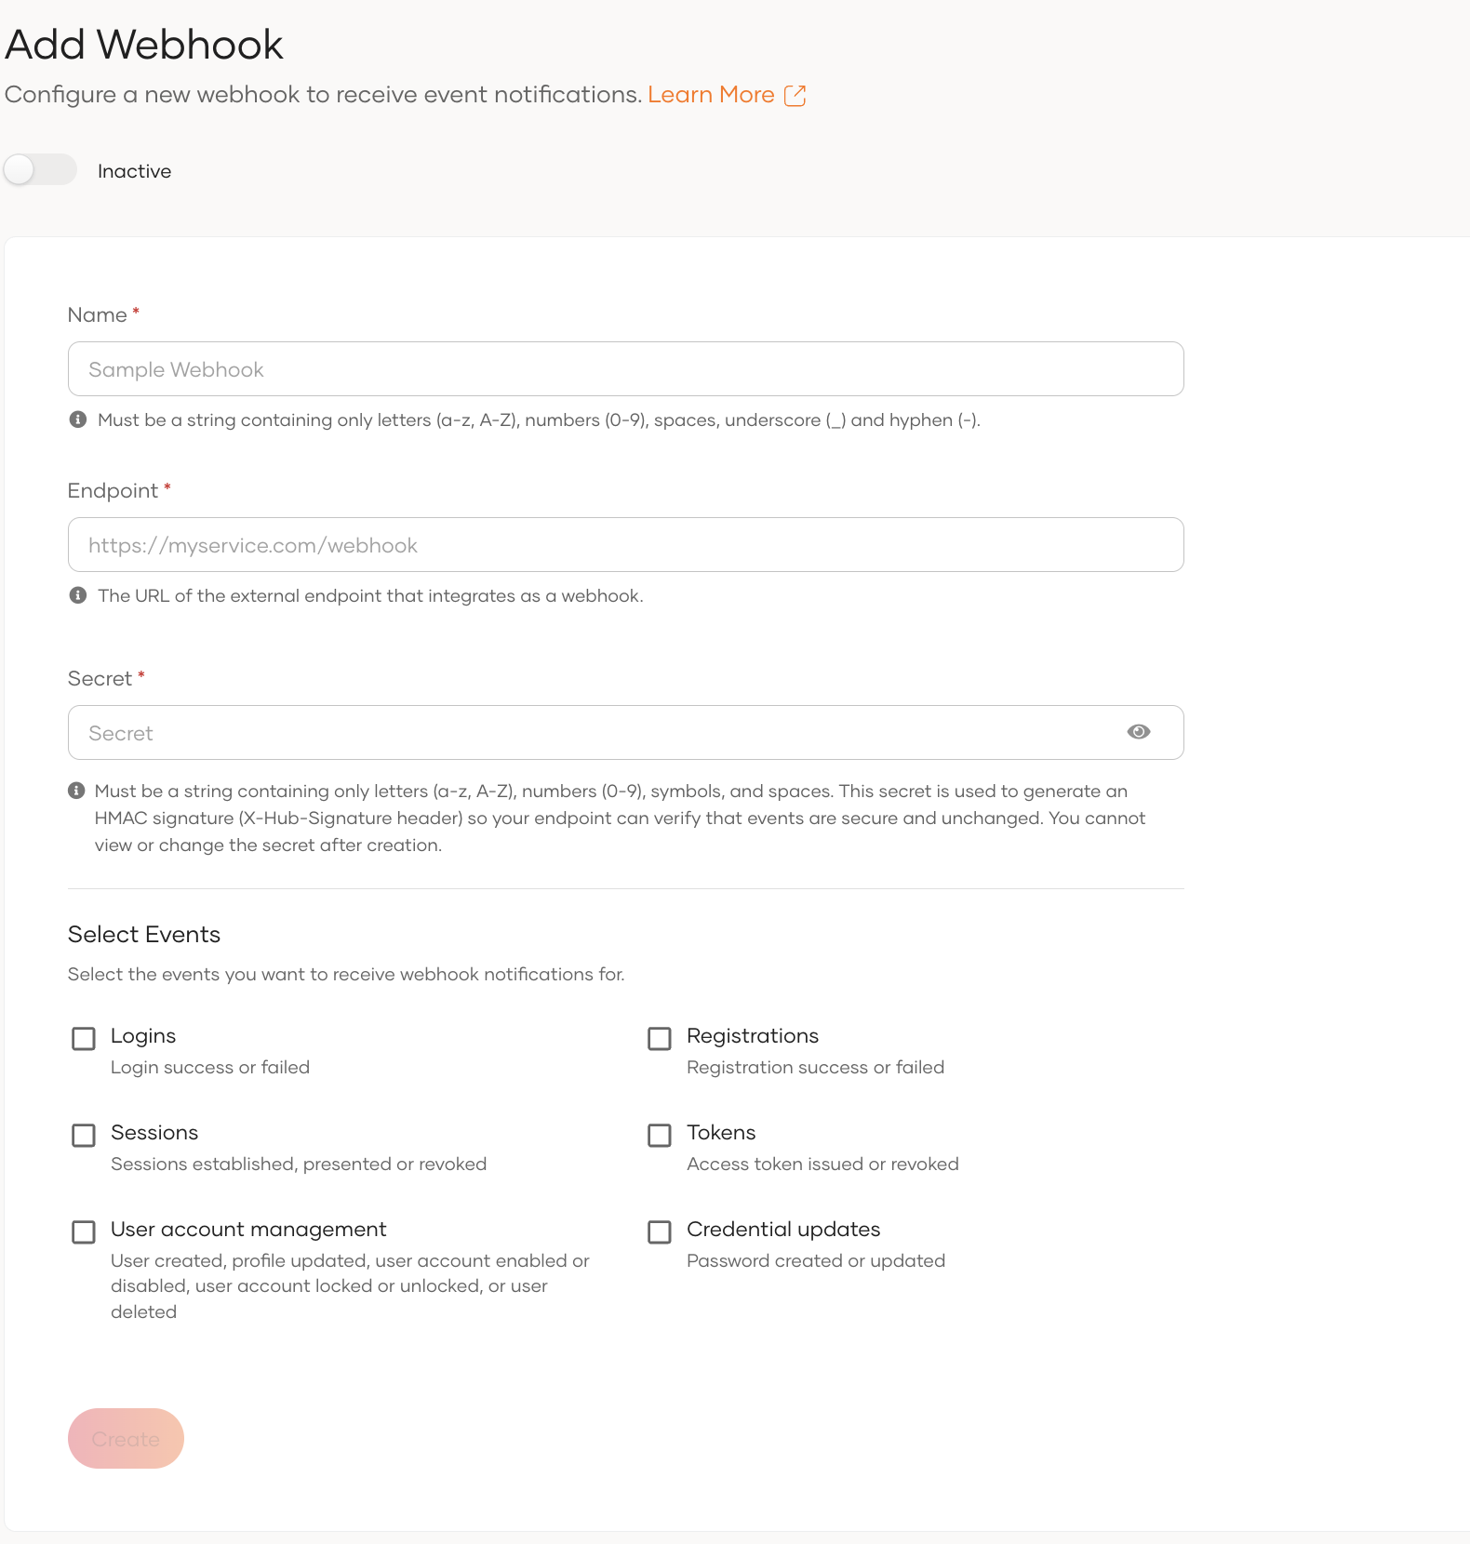
Setting up a webhook

Slide 28
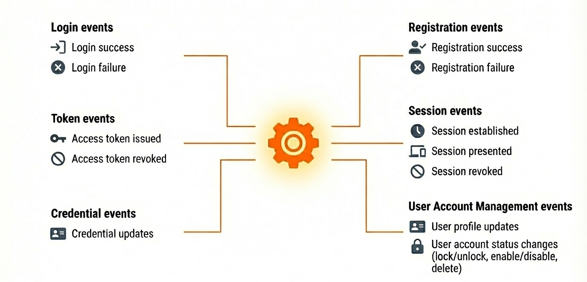
Webhook event types

Slide 29
Quick Recap

Slide 30

Extension points
Java Based Extension Points
Custom event handler, user store listeners, post authentication handlers, and custom claim handlers
Actions
Webhooks
What you learnt

Slide 31



Any Questions ?
Reach us through the following channels
iam-dev@wso2.org
https://stackoverflow.com/questions/tagged/wso2-identity-server
https://discord.com/invite/Xa5VubmThw

Slide 32
Thank you!
Notes:
Acknowledge that it’s been a lot of changes within the team
Thank you for your taking onboard the feedback and being open to change.
A lot of work , a lot of learning, sometimes feeling twice the exhaustion
But also hopefully seeing what I see, which is: better ways of working, more innovation in our approach, more business acumen, more effective reactivity , more ahead of the game. Because that’s where marketing needs to be.
All this in a context where it’s also been a lot of changes for WSO2.
And from this standpoint I wanted to remind you of what Sanjiva said about you owning the culture

